Slide 1

LINEAR CONTROL
SYSTEMS
Ali Karimpour
Assistant Professor
Ferdowsi University of Mashhad
Notes:
<<<1.1>>>
###Control System Design###
{{{Control, Design}}}

Slide 2
Lecture 18
Time domain design of control systems
Topics to be covered include:
Design of controller in time domain.
  Various controller configurations.
  Different kind of controllers.
  Controller realization.
  Effects of PID control on the time response.

Slide 3
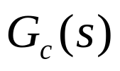
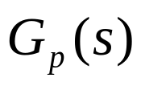
Various controller configurations.
ساختارهای کنترلی متفاوت
1 Series or cascade compensation.
1 ساختار کنترلی سری
r(t)
+
e(t)
u(t)
c(t)
-
Controller
Controlled
process

Slide 4
Various controller configurations.
ساختارهای کنترلی متفاوت
2 Feedback compensation.
2 جبران سازی فیدبکی
Controlled
process
r(t)
+
e(t)
+
u(t)
c(t)
G
(
s
)
-
-
p
Controller

Slide 5


Various controller configurations.
ساختارهای کنترلی متفاوت
3 State-feedback control.
3 کنترل فیدبک حالت
r(t)
+
u(t)
x(t)
c(t)
G
(
s
)
-
p
Controlled
process
Controller

Slide 6
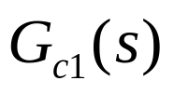

Various controller configurations.
ساختارهای کنترلی متفاوت
Series-feedback compensation.
(Two degree of freedom)
4 جبران سازی سری فیدبکی (دو درجه آزادی)
Controlled
process
r(t)
+
e(t)
+
u(t)
c(t)
G
(
s
)
-
-
p
Compensation
Controller
Controller

Slide 7
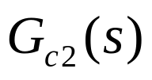
Various controller configurations.
ساختارهای کنترلی متفاوت
5 Forward compensation with series compensation. (Two degree of freedom)
5 جبران سازی پیش رو با جبران سازی سری (دو درجه آزادی)
Controlled
process
r(t)
+
e(t)
u(t)
c(t)
G
(
s
)
-
p
Controller
Controller

Slide 8
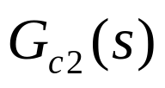
Various controller configurations.
ساختارهای کنترلی متفاوت
6 Feed forward compensation.
(Two degree of freedom)
6 کنترلر پیش خور (دو درجه آزادی)
Controller
Controlled
process
r(t)
+
e(t)
+
u(t)
c(t)
G
(
s
)
-
+
p
Controller

Slide 9
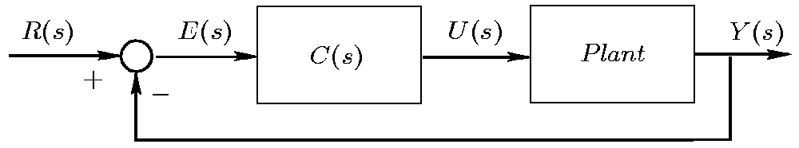
Series Compensation Structure
جبران سازی سری
In this Course consider the simple SISO control loop shown in the figure.
Series or cascade compensation.
ساختار کنترلی سری
Controller
There is a lot of different controller!
Notes:
<<<6.2>>>

Slide 10
In This course
Different kind of controllers
انواع کنترلر
PID controllers.
Lead lag controllers
Different
kind of
controllers
In Graduate courses
H₂ Controllers
H∞ Controllers
…………..
Adaptive Controllers
Intelligent Controllers
NN Controllers
…………..

Slide 11
PID Controllers
کنترلر PID
PID has become almost universally used in industrial control.
These controllers have proven to be robust and extremely beneficial in the control of many important applications.
PID stands for: P (Proportional)
I (Integral)
D (Derivative)

Slide 12
Historical Note
وضعیت تاریخی
Early feedback control devices implicitly or explicitly used the ideas of proportional, integral and derivative action in their structures.
However, it was probably not until Minorsky’s work on ship steering* published in 1922, that rigorous theoretical consideration was given to PID control.
This was the first mathematical treatment of the type of controller that is now used to control almost all industrial processes. (more that 95% of closed-loop industrial processes.)
* Minorsky (1922) “Directional stability of automatically steered bodies”,
J. Am. Soc. Naval Eng., 34, p.284.

Slide 13
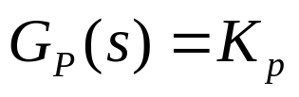
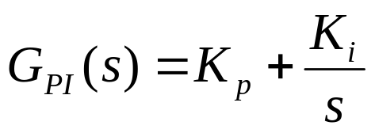
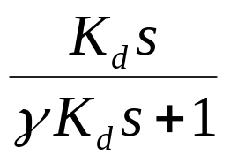
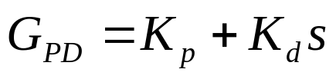
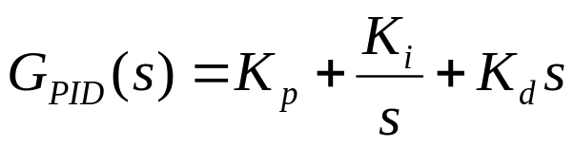
PID Controllers
کنترلر PID
The standard form PID are:
Proportional only:
Proportional plus Integral:
Proportional plus derivative:
Proportional, integral and
derivative:

Slide 14
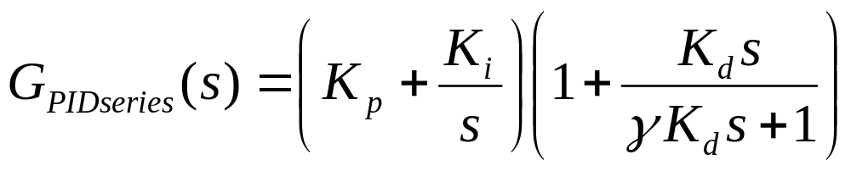
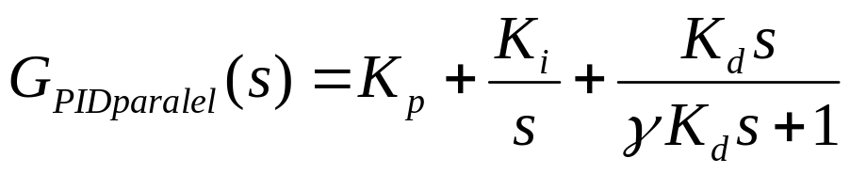
PID Controllers
کنترلر PID
An alternative series form is:
Yet another alternative form is the, so called, parallel form:
?

Slide 15
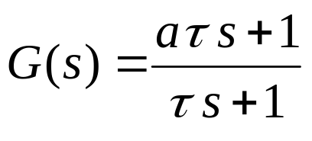
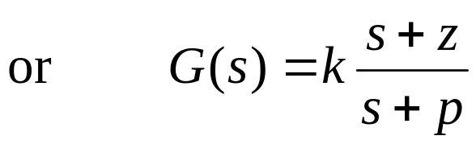
Lead-lag Compensators
کنترلر پیش فاز پس فاز
Closely related to PID control is the idea of lead-lag compensation. The transfer function of these compensators is of the form:
If a<1 , then this is a lag network. Or (z>p) in other form.
If a>1 this is a lead network. Or (z<p) in other form.
Notes:
<<<6.6>>>
###Lead-Lag###
{{{Lead, Lag}}}

Slide 16
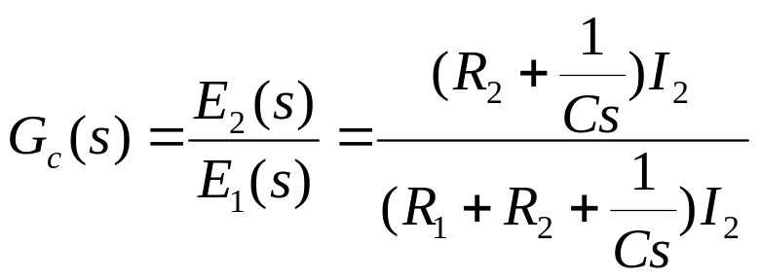
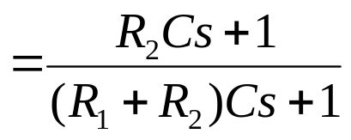
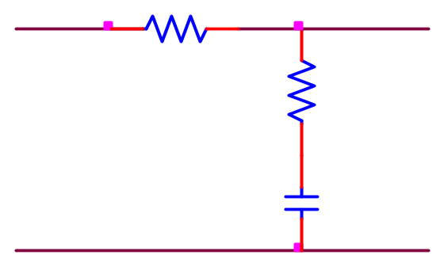

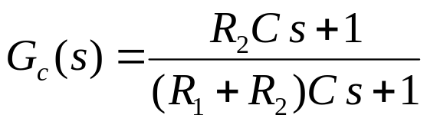

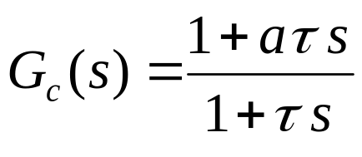
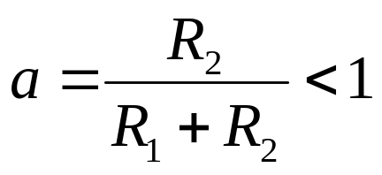
A phase Lag network
یک شبکه پس فاز
R₁
+
+
R₂
E₁
E₂
C
-
-
So it is a Lag network

Slide 17
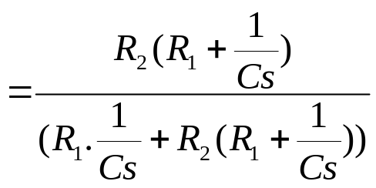
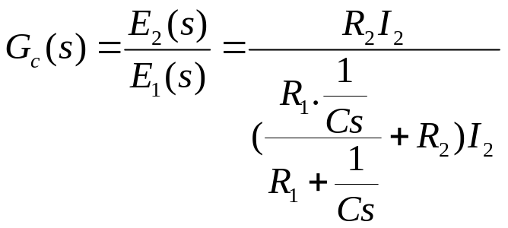
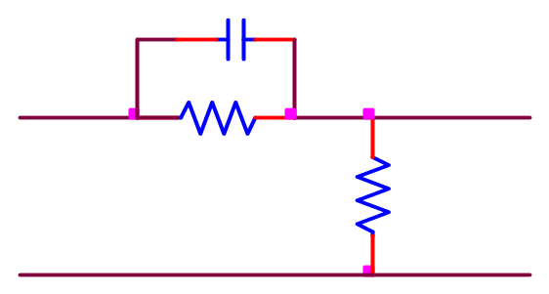
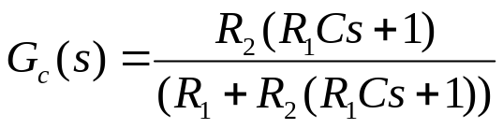
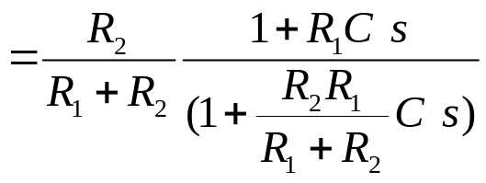


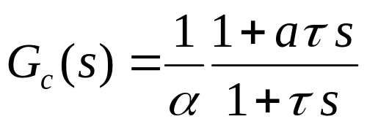
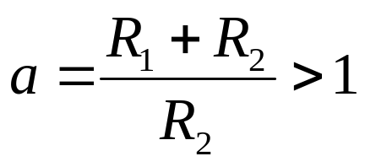
A phase Lead network
یک شبکه پیش فاز
C
+
R₁
+
E₁
R₂
E₂
-
-
So it is a Lead network

Slide 18
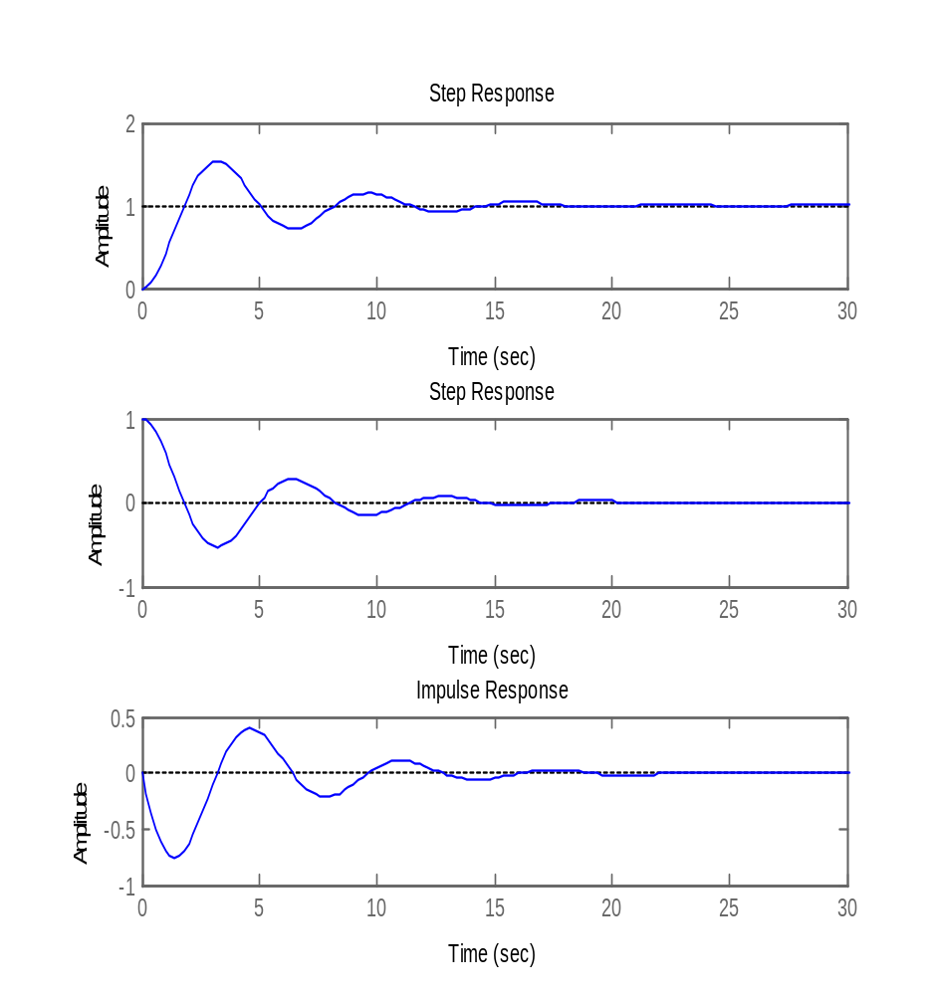



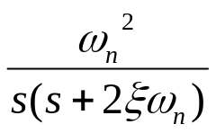





Effects of the PD control on the time response.
تاثیر کنترلر PD بر پاسخ زمانی
+
+
-
+
PD controller
Derivative part can improve
the oscillation.
جمله مشتق می تواند رفتار گذرا را بهبود بخشد.

Slide 19

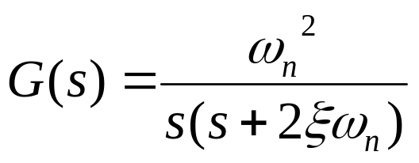
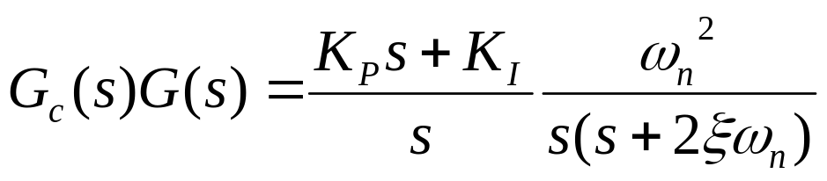
Effects of the PI control on the time response.
تاثیر کنترلر PI بر پاسخ زمانی
+
+
-
+
PI controller
Loop transfer function without controller
Loop transfer function with controller
PI control can improve error by increases the type of system by one

Slide 20
Exercises
تمرینها
Notes:
<<<3.6>>>
###State Space Models###

